Slide 1
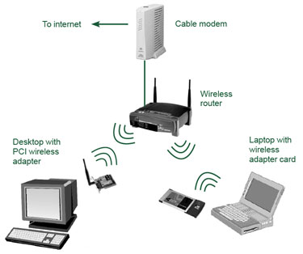
Wireless is a term used to describe telecommunications in which electromagnetic waves (rather than some form of wire) carry the signal over part or all of the communication path. Some monitoring devices, such as intrusion alarms, employ acoustic waves at frequencies above the range of human hearing; these are also sometimes classified as wireless

Slide 2
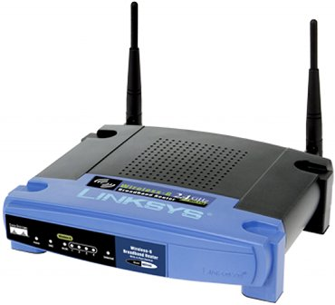
The first wireless transmitters went on the air in the early 20th century using radiotelegraphy -Morse code-. Later, as modulation made it possible to transmit voices and music via wireless, the medium came to be called "radio." With the advent of television, fax, data communication, and the effective use of a larger portion of the spectrum, the term "wireless" has been resurrected.

Slide 3
Wireless technology is rapidly evolving, and is playing an increasing role in the lives of people throughout the world. In addition, ever-larger numbers of people are relying on the technology directly or indirectly. (It has been suggested that wireless is overused in some situations, creating a social nuisance.) More specialized and exotic examples of wireless communications and control include:

Slide 4

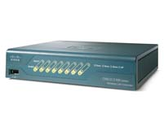
For medium-to-large enterprise facilities
The Cisco 4402 with 2 Gigabit Ethernet ports supports configurations for 12, 25, and 50 access points
Cisco 4404 with 4 Gigabit Ethernet ports supports 100 access points
For small and medium-sized businesses or branch offices
Business-class RF security and WLAN security policy monitoring
Simplified network deployment, operations, and management to help reduce overall operational expenses

Slide 5
Done by:
FATON MEHMETI & ARDIAN MEHMETI 9E

